Slide 1
How to Set up a Theme for Jupyter Slides
Rita Rozental
Notes:
Be specific and direct in the title. Use the subtitle to give the specific context of the speech.
-The goal should be to capture the audience’s attention which can be done with a quote, a startling statistic, or fact. It is not necessary to include this attention getter on the slide.

Slide 2
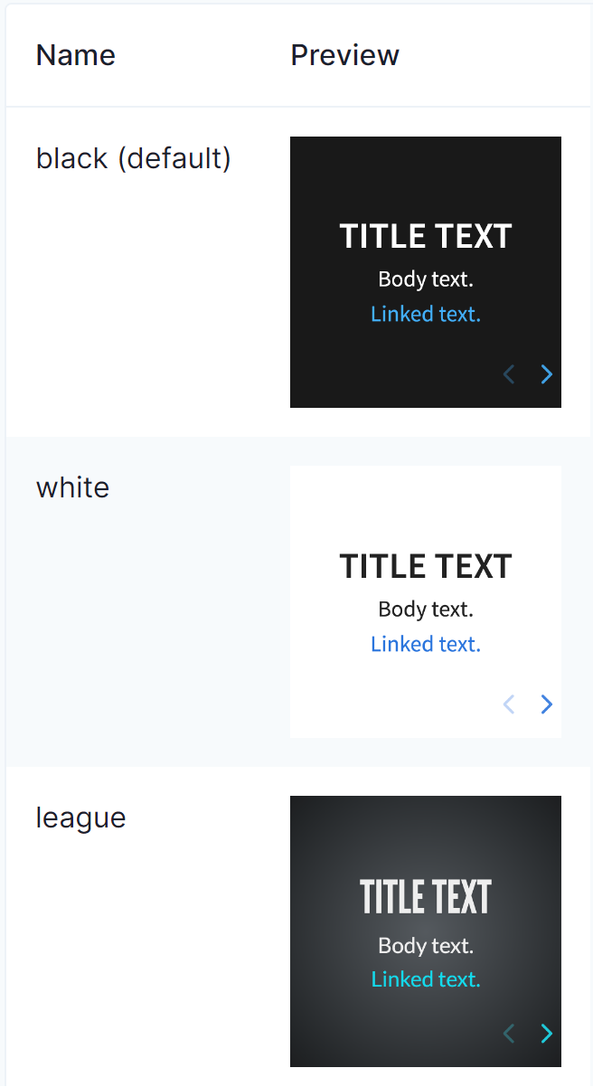
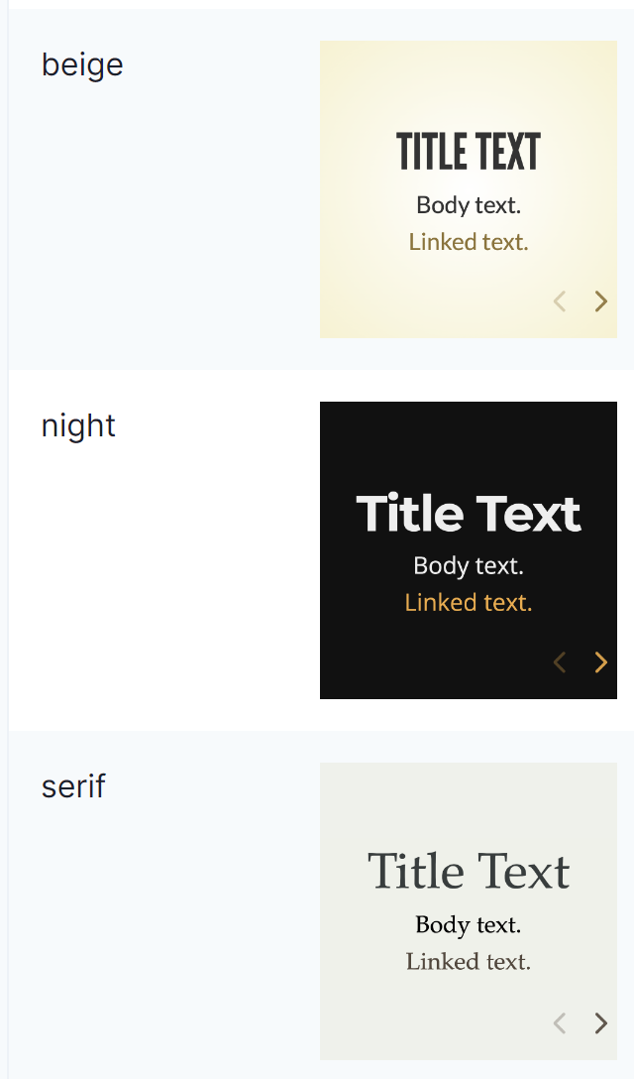
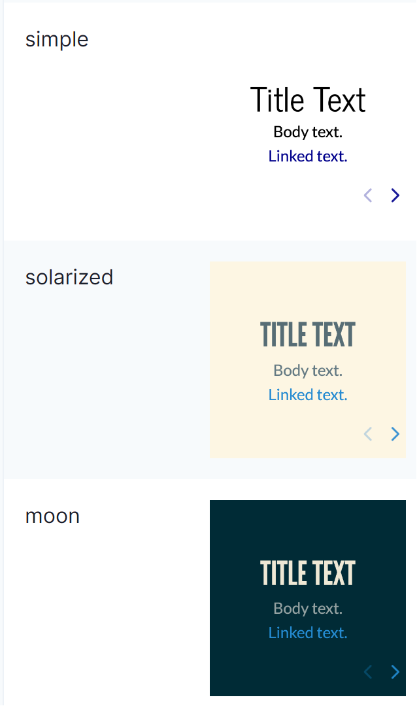
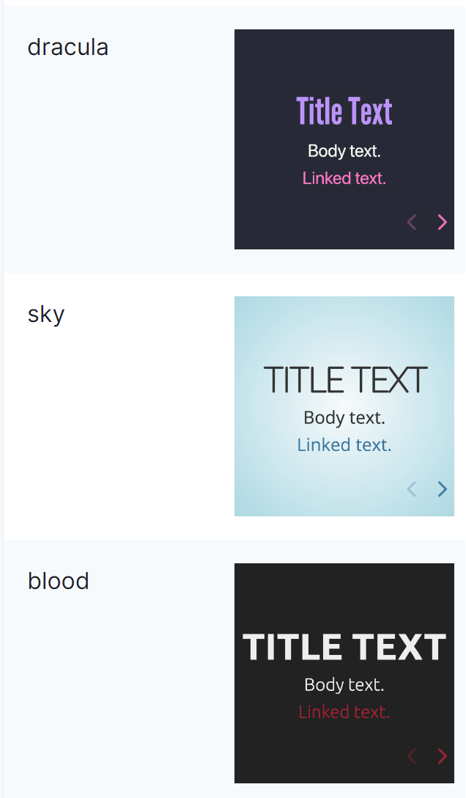
https://revealjs.com/themes/
Notes:
Use the background points to post details that are not common knowledge, or that the audience will need to understand the context of the speech.
-Do not read these main points from the PowerPoint, instead elaborate on these points during the speech.

Slide 3
Do not use GitHub – it is sccs file format and will not work! On cdnjs, search for reveal.js and look for the theme files in the list (they usually end in .css).
Notes:
Dedicate this entire slide to the thesis statement. It is the reason the speech is being given. Use this time to reveal the three main points of the speech (slides 4,5,6) as an overview for the direction of the speech:
-[type main point #1 here]
-[type main point #2 here]
-[type main point #3 here]
Be sure to transition to the first main point and the next slide.

Slide 4
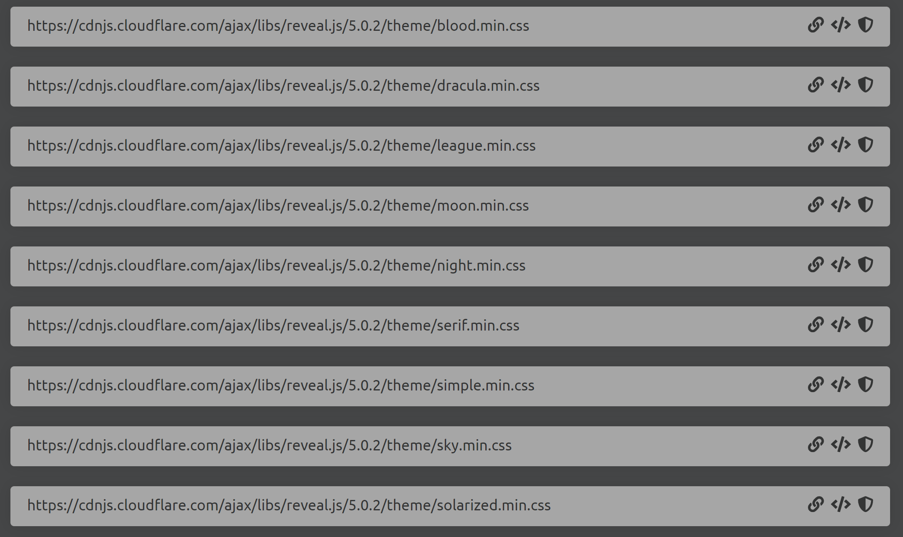
https://cdnjs.com/libraries/reveal.js
Notes:
The title of main point #2 should be clear and concise. Each piece of evidence should be summarized for clarity and cited correctly. Do not simply read the pieces of evidence, but elaborate where needed.
[type notes for elaboration here]
Be sure to transition to main point #3 and the next slide.

Slide 5

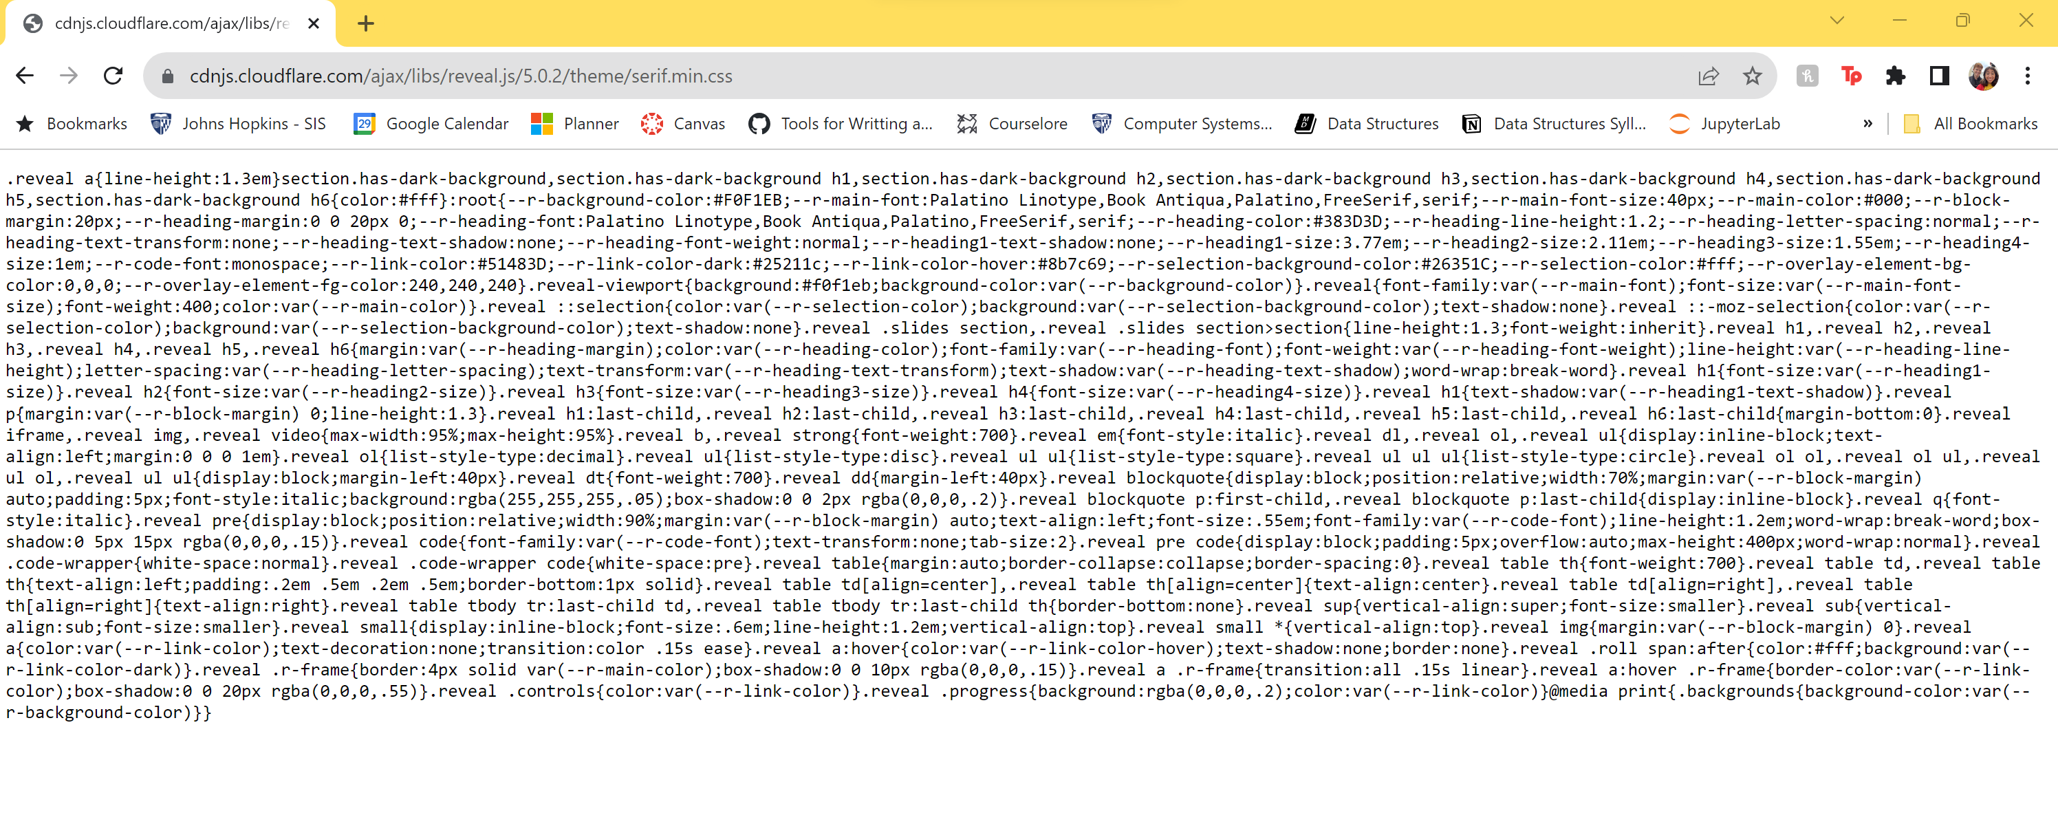
https://cdnjs.cloudflare.com/ajax/libs/reveal.js/5.0.2/theme/serif.min.css
Notes:
The title of main point #2 should be clear and concise. Each piece of evidence should be summarized for clarity and cited correctly. Do not simply read the pieces of evidence, but elaborate where needed.
[type notes for elaboration here]
Be sure to transition to main point #3 and the next slide.

Slide 6
You can include CSS by embedding it directly in a %%html cell at the beginning of your notebook.
Notes:
The title of main point #2 should be clear and concise. Each piece of evidence should be summarized for clarity and cited correctly. Do not simply read the pieces of evidence, but elaborate where needed.
[type notes for elaboration here]
Be sure to transition to main point #3 and the next slide.

Slide 7
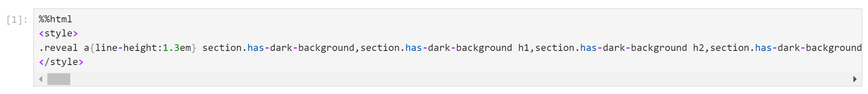
%%html<style> Copy and Paste text from cdnjs link here! </style>A
Notes:
The title of main point #2 should be clear and concise. Each piece of evidence should be summarized for clarity and cited correctly. Do not simply read the pieces of evidence, but elaborate where needed.
[type notes for elaboration here]
Be sure to transition to main point #3 and the next slide.

Slide 8
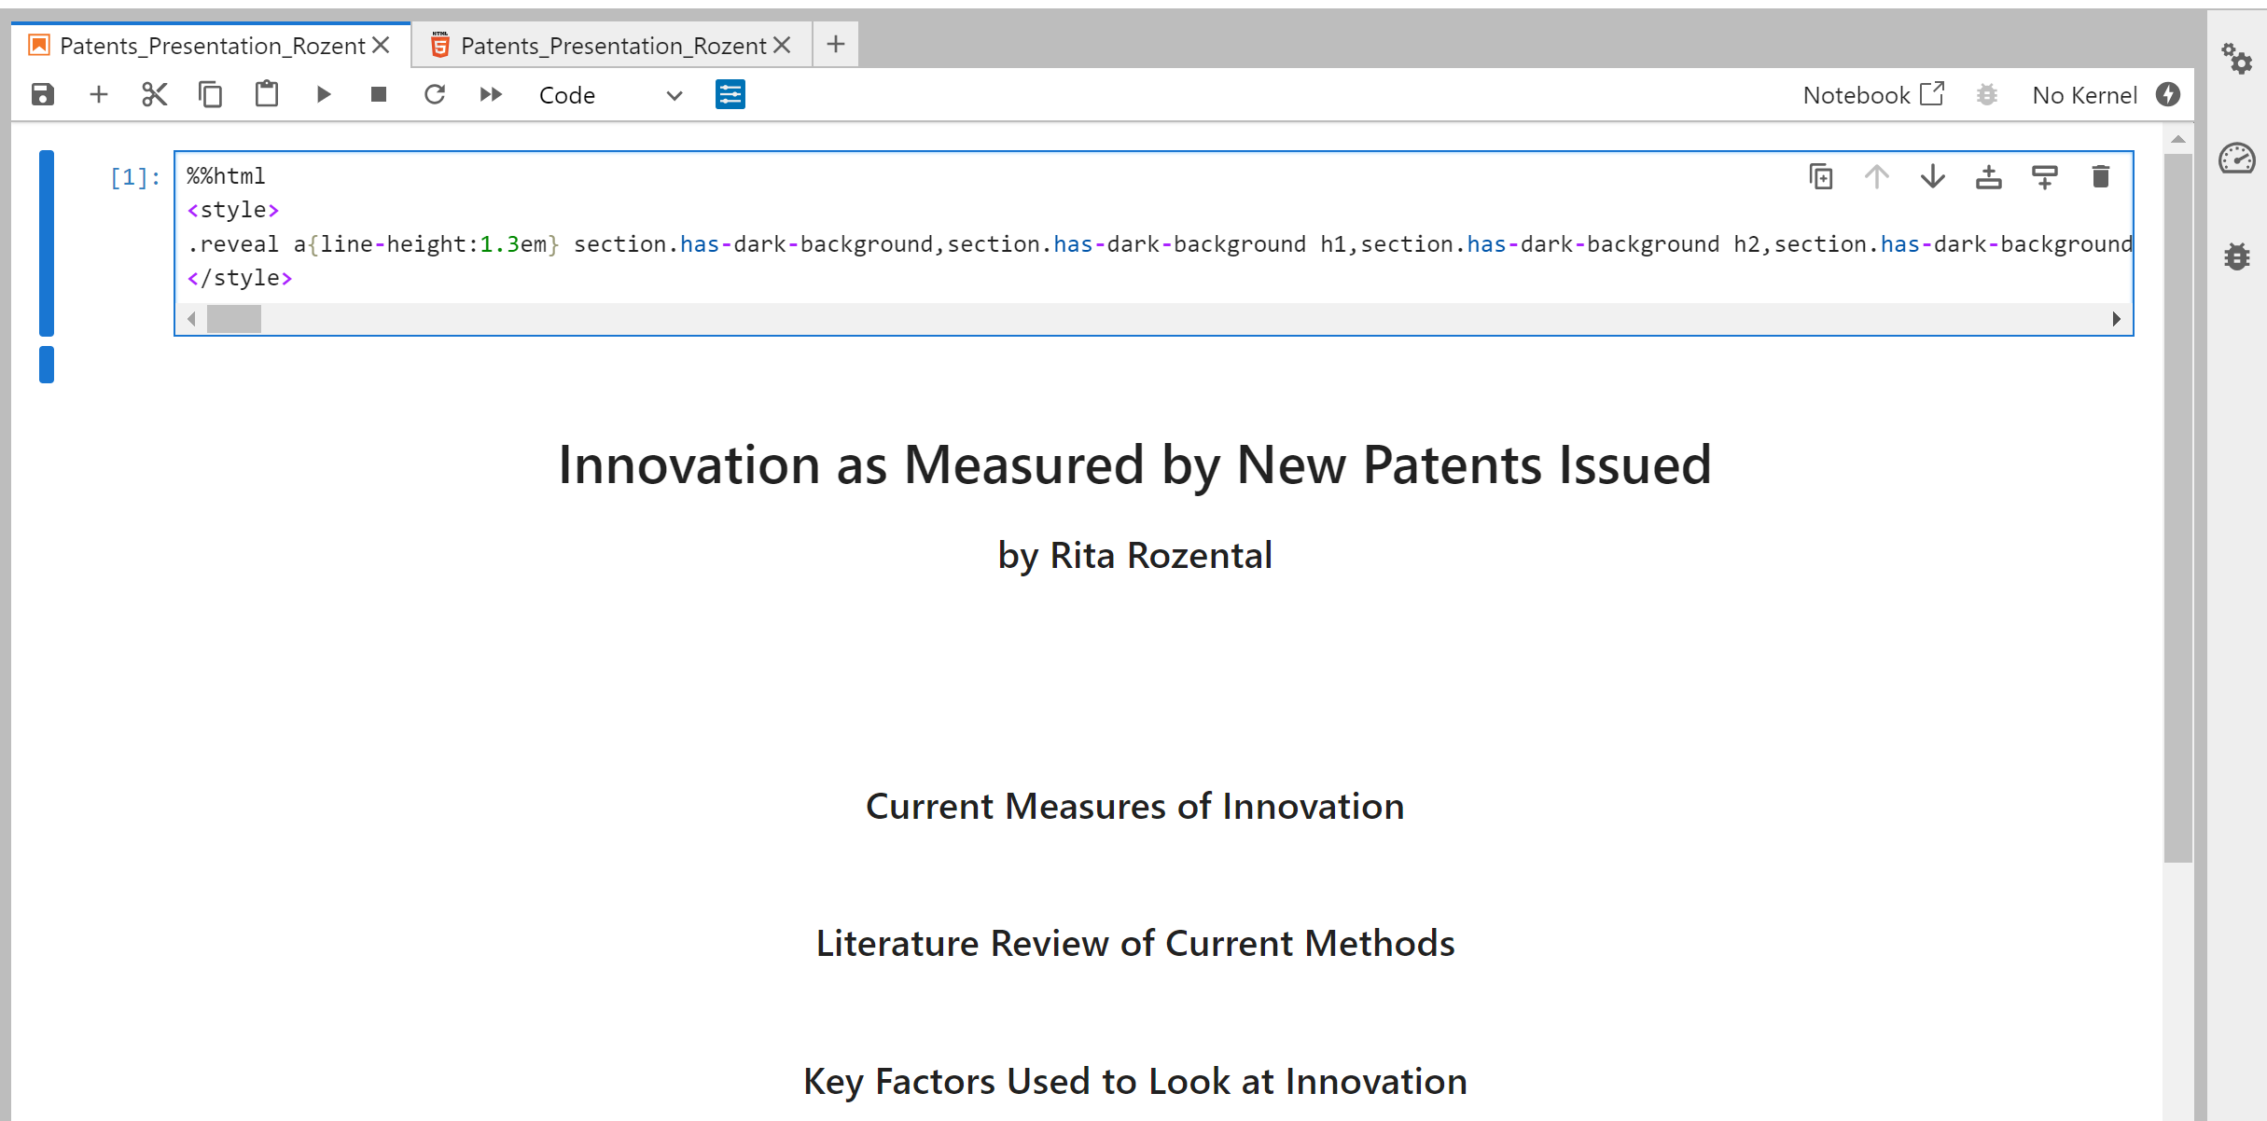
Add RISE Configurations to Notebook Metadata

Slide 9
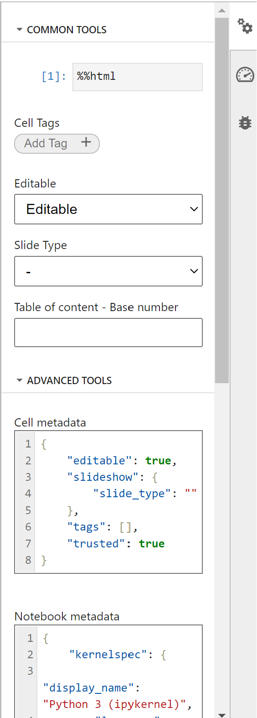
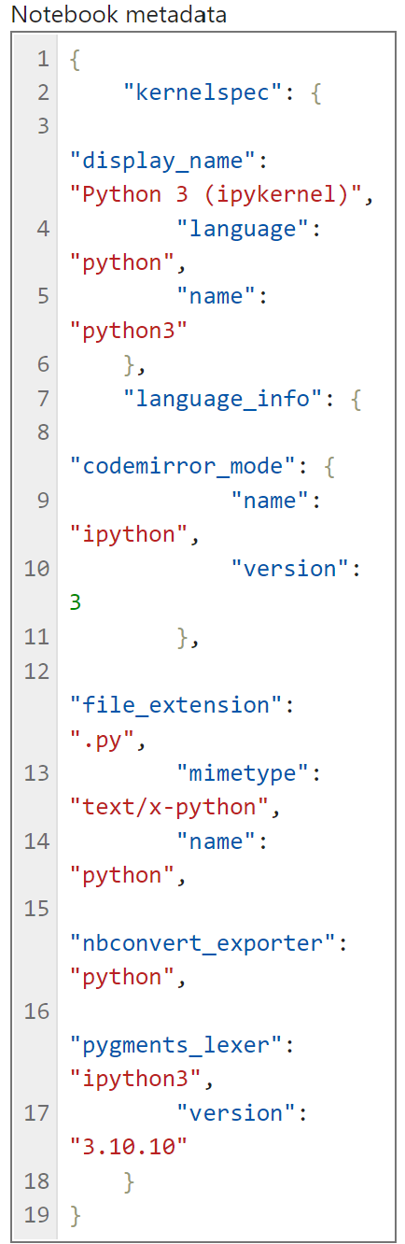
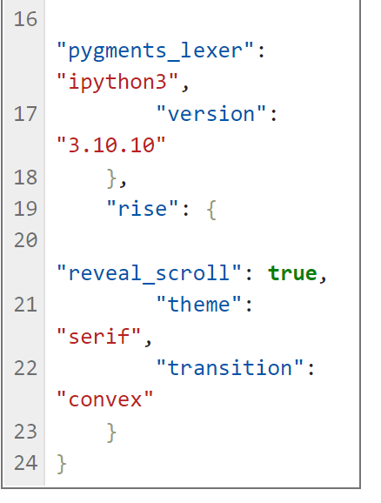
Scroll to bottom of “Notebook meta data”. Screenshot on left is your current code.
Add the following code from line 19 to 20. Replace “serif” with your theme name if you picked a different theme.

Slide 10
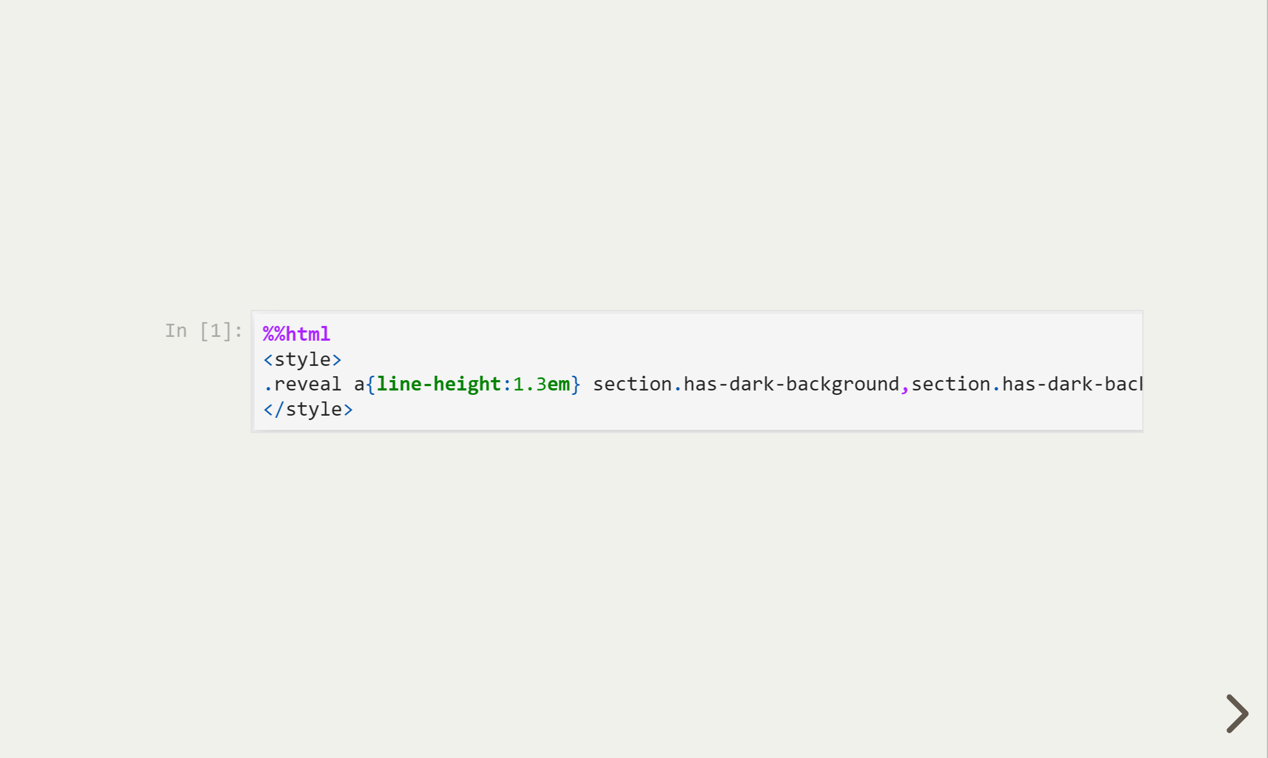

You should now have:

Slide 11
Now we just have to hide the first slide!
Notes:
The title of main point #2 should be clear and concise. Each piece of evidence should be summarized for clarity and cited correctly. Do not simply read the pieces of evidence, but elaborate where needed.
[type notes for elaboration here]
Be sure to transition to main point #3 and the next slide.

Slide 12
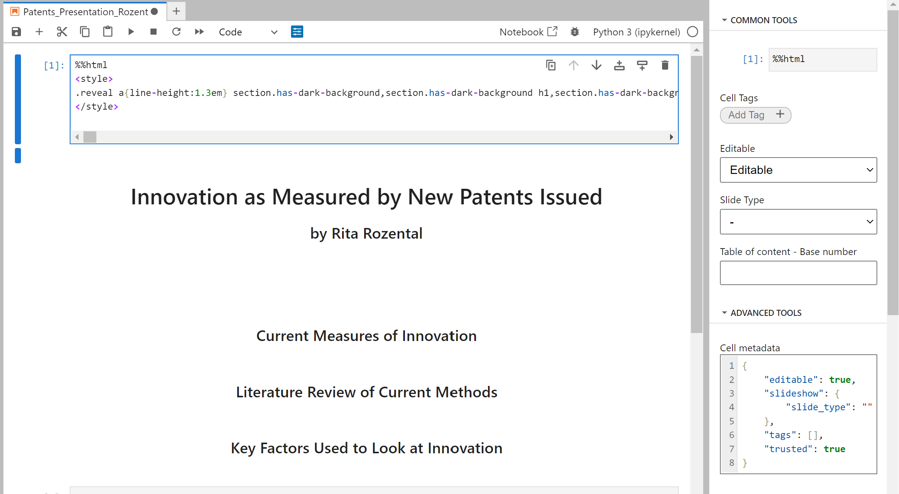
Select code cell and open settings

Slide 13
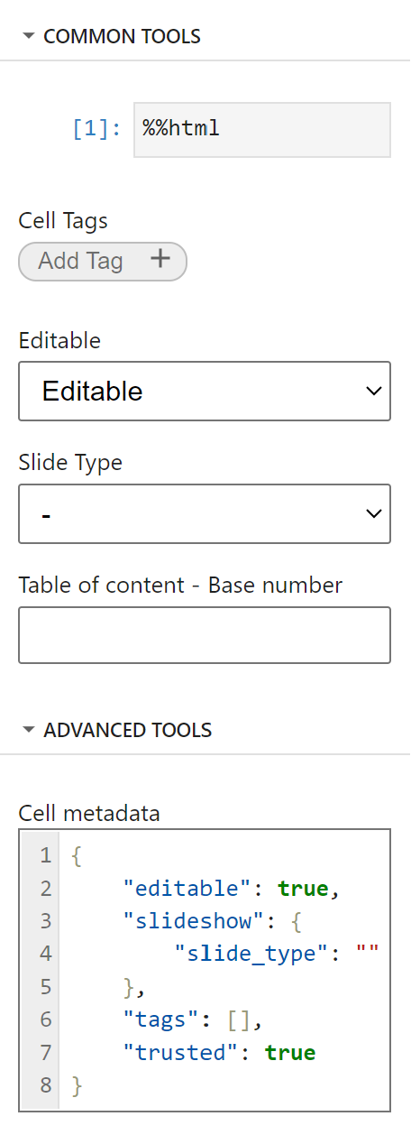
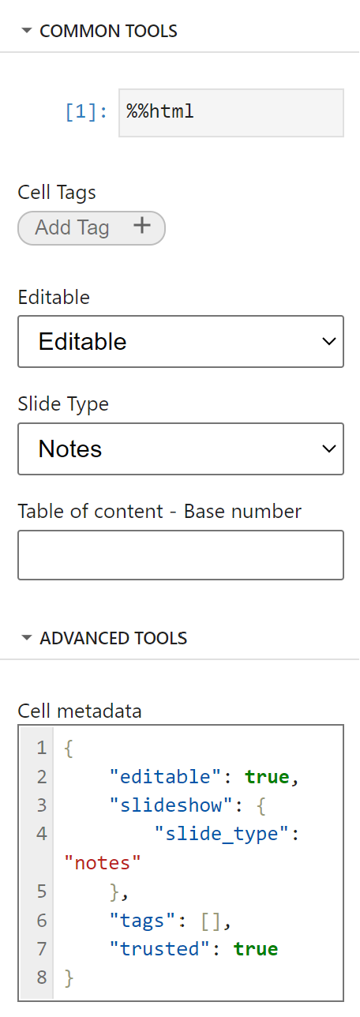
Change cell metadata
Change:
To

Slide 14

Save and you’re done!

